Slide 1
An analysis of the San-Diego Traffic Collisions dataset (final Dataset selection)
By: Neil Kingdom

Slide 2
Question:
Which factors provided within the San-Diego Traffic Collisions dataset contribute the most towards vehicle-related incidents involving injury and/or homicides?

Slide 3
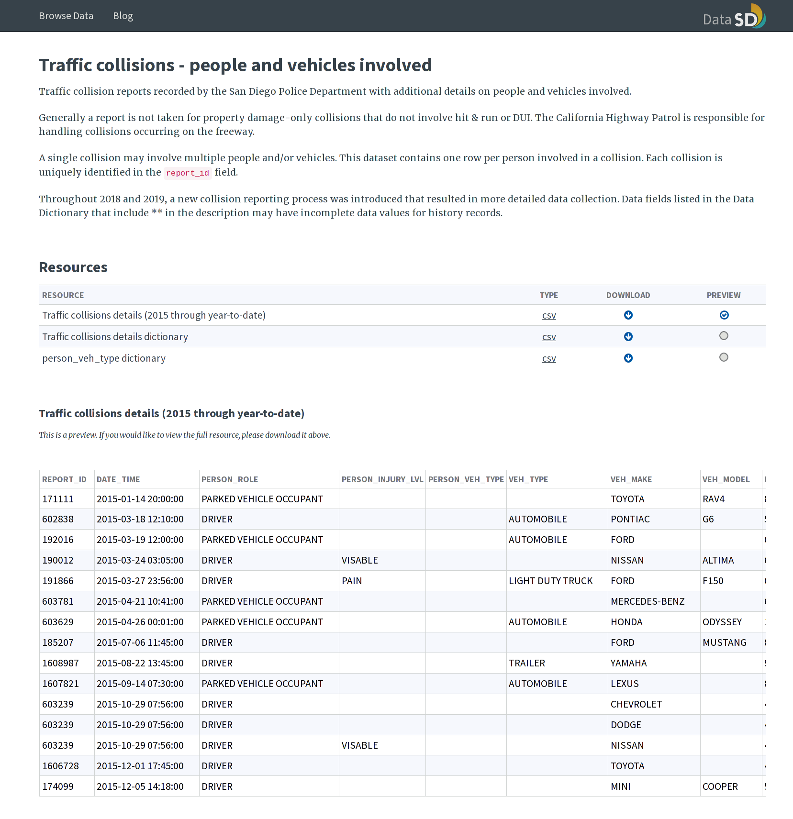
Data Understanding
The San-Diego Traffic Collision dataset contains an initial count of 119,297 instances and 22 attributes
Each instance within the dataset represents a single person involved in a vehicle-related incident
There are records dating from 2015 to current year (2023)
Link: https://data.sandiego.gov/datasets/police-collisions-details/

Slide 4
DATA UNDERSTANDING (ATTRIBUTES)
Report ID: The collision report number
Date-time: The date-time at which the collision was reported
Person Role: A description of the victim’s role in the collision e.g., driver, passenger, cyclist, etc.
Injury Level: A nominal value describing the severity of the injury (if applicable)

Slide 5
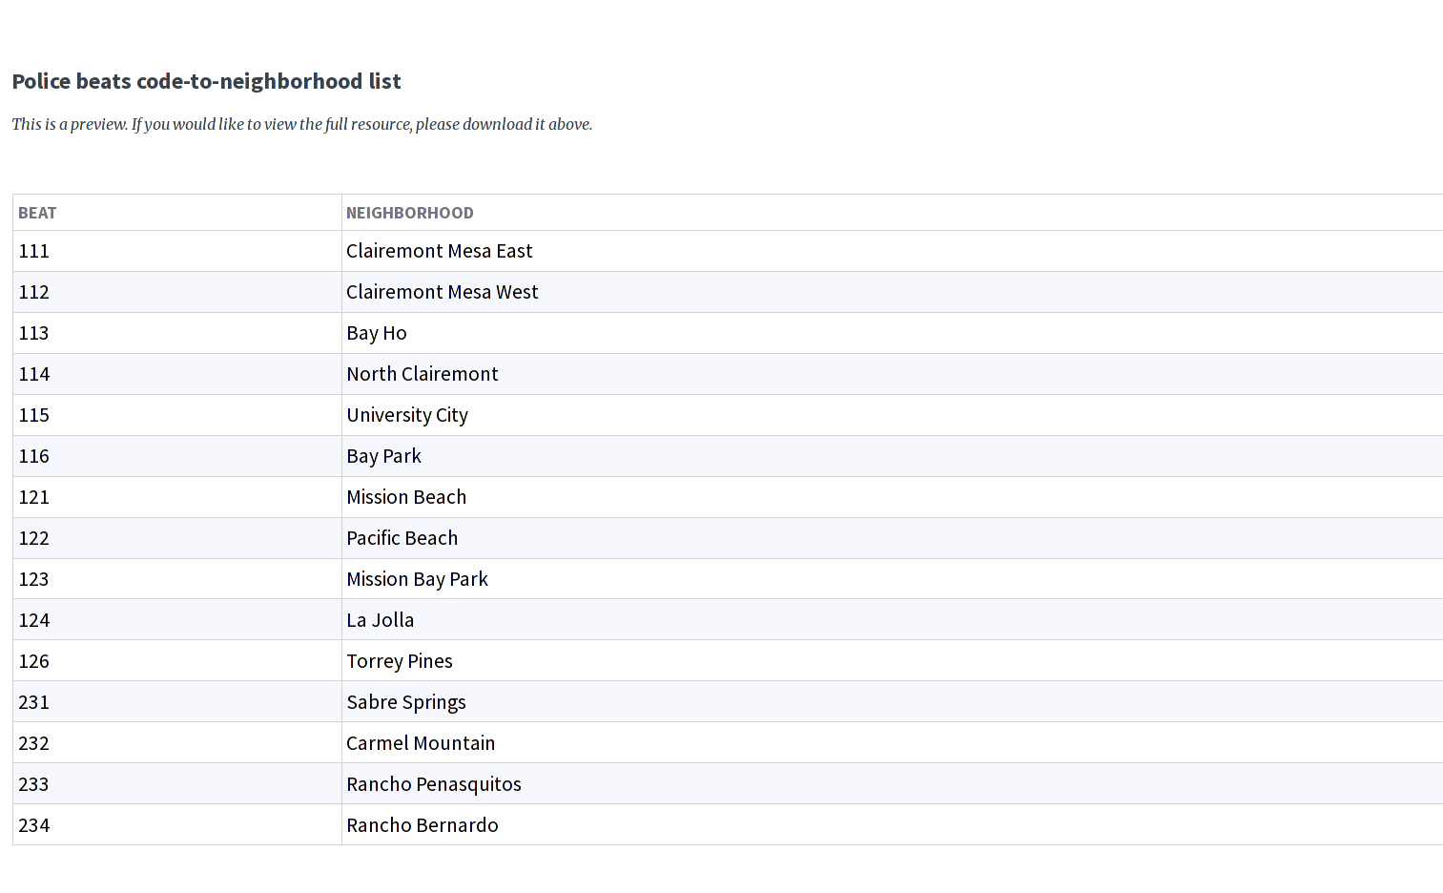
DATA UNDERSTANDING (ATTRIBUTES)
Vehicle Type: A broad classification describing the type of vehicle involved in the collision
Vehicle Make: Make of the vehicle
Vehicle Model: Model of the vehicle
Police Beat: The San-Diego Police beat i.e., the patrol area for a particular juristiction

Slide 6
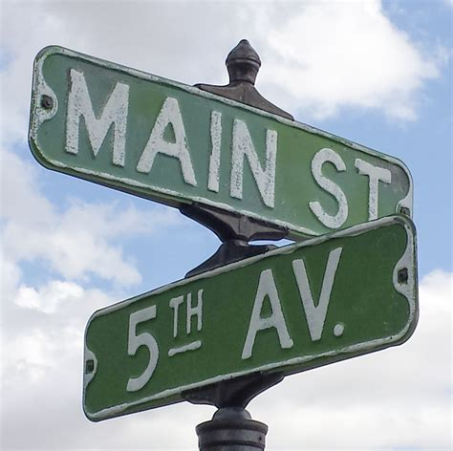
DATA UNDERSTANDING (ATTRIBUTES)
Address Number Primary: Street number of location at which the collision occurred
Street Name: The name of the street
Street Direction: Direction of the street (N, S, E, W)
Address Suffix: The type of street (e.g., road, avenue, boulevard)
Only applicable if collision occurred at an intersection:
Direction of Cross Street: Direction of the cross street
Cross Street Name: The name of the cross street
Cross Street Suffix: The type of cross street

Slide 7
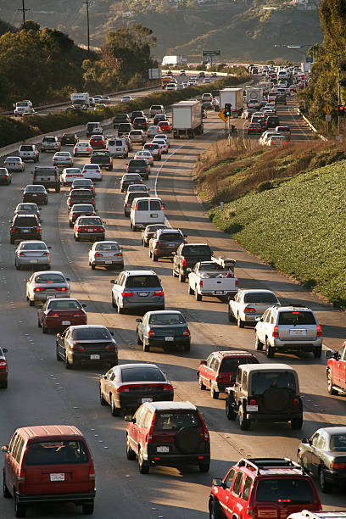
DATA UNDERSTANDING (ATTRIBUTES)
Violation Section: The California Vehicle Code (CVC) associated with the violation type
Violation Type:
CO (City/County Ordinances)
HN (Harbors and Navigation)
HS (Health and Safety)
MC (Mixed Commercial)
PC (Penal Code)
VC (Vehicle Code)
ZZ (Miscellaneous)
Injured: The number of people injured in the collision
Killed: The number of people killed in the collision
Hit and Run Level: Either felony, misdemeanor, or not applicable

Slide 8
DATA UNDERSTANDING (HYPOTHESIS)
I hypothesised that the following attributes would have a correlation with injury and/or homicides:
Date-time: Friday, Saturday, and Sunday are busier, as well as rush hour (~7am to 9am and ~4pm to 6pm), leading to more collisions during these times
Person Role: Motorcyclists, bicyclists and pedestrians are more likely to get injured/killed than the passenger of a vehicle, for instance
Vehicle type: Larger vehicles are likely to cause more severe collisions and vehicles such as motorcycles or bicycles are more likely to be victims of severe collisions
Police beat: Juristictions with busier streets may be associated with a higher frequency of collisions

Slide 9
DATA UNDERSTANDING (HYPOTHESIS)
Address Suffix: Busier types of roads will cause more severe accidents
Address Direction: San-Diego is on the West coast of California, towards the South. I predicted that there would be more collisions towards the State borders at the North-East of San-Diego, as this is where people are entering/exiting the City
Violation section/type: The violation type and section will have a correlation with injury and/or homicides, considering certain violation sections are likely more severe than others
Hit and Run Level: Felonies, by definition, are associated with high rates of injury and/or homicide, whereas misdemeanors are, by definition, associated with lower rates of injury and/or homicide, therefore, this was the expected outcome

Slide 10
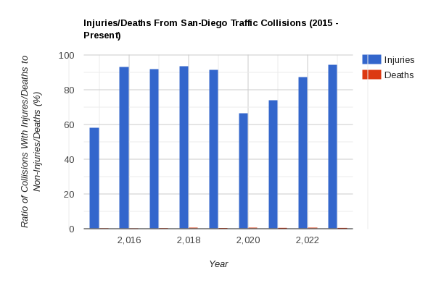
DATA UNDERSTANDING (EXPLORATION)
The ratio of collisions involving injuries/deaths to those which did not involve injuries/deaths
Injuries is marked in blue. Deaths are marked in red.
Note the dip in 2020 when restrictions were being placed on travel due to the Covid-19 pandemic
2015 is an outlier, as there were only 19 total instances recorded

Slide 11
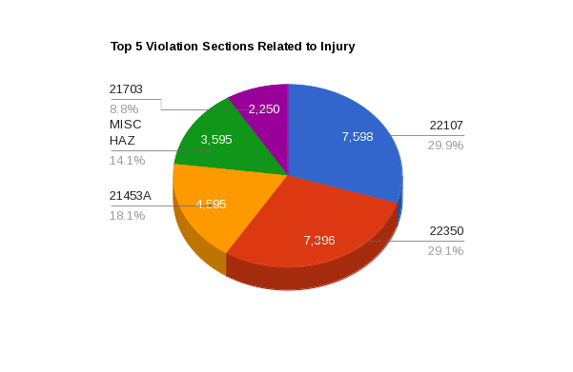
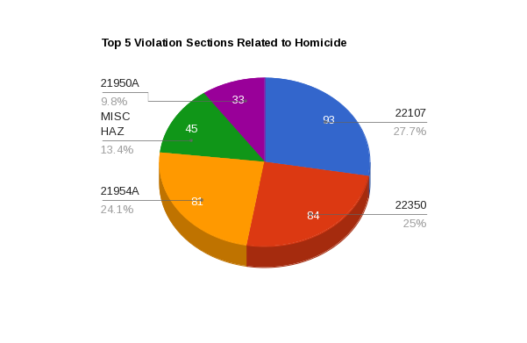
DATA UNDERSTANDING (EXPLORATION)
Violation sections 22107 (unsafe turning) and 22350 (speeding) are the top two violation sections for both injuries and homicides
In third for injuries is 21453A (not stopping for a red light) and 21954A (pedestrians not giving the right of way e.g., jaywalking) for homicides
Miscellaneous road hazards share fourth place for both injuries and homicides
Finally, 21703 (tailgating) was the fifth highest cause of injury and 21950A (cars not giving the right of way to pedestrians) was the fifth highest cause of homicides

Slide 12
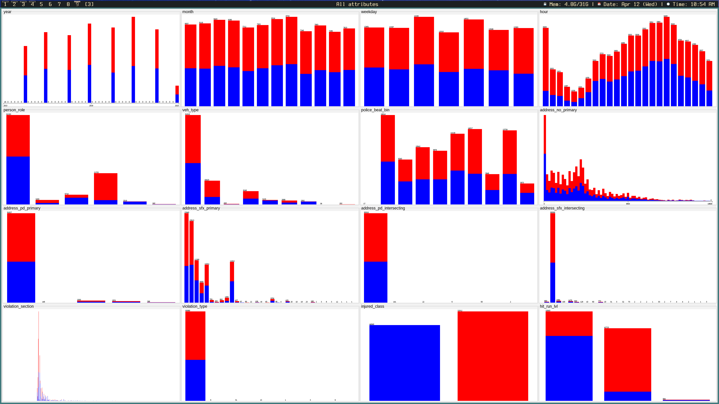
DATA UNDERSTANDING (EXPLORATION)
Injured
Not Injured

Slide 13
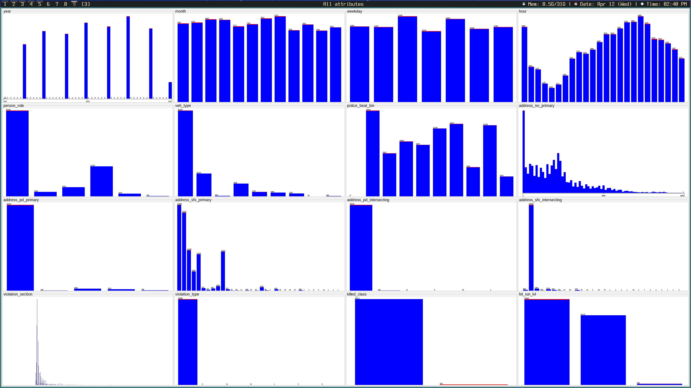
DATA UNDERSTANDING (EXPLORATION)
Survived
Killed

Slide 14
DATA PREPARATION (SELECTION)
Left Intact Removed
Person Role
Vehicle Type
Primary Address Number
Primary Address Direction
Primary Address Suffix
Intersecting Address Direction
Intersecting Address Suffix
Violation Section
Violation Type
Hit and Run Level
Report ID
Date-time
Injury Level
Person Vehicle Type
Vehicle Make
Vehicle Model
Police Beat
Primary Address Name
Intersecting Address Name
Charge Description

Slide 15
DATA PREPARATION (CONSTRUCTION)
Date-time (YYYY-MM-DD HH:MM:SS) → Year, Month, Weekday, Hour
Police Beat (numeric 3-999) → Used equal frequency binning with a bin size of 100 (10 bins total)
Google Image search was used to determine vehicle type based on make and model
Created Injured class and Killed class → IF (injury_count > 0) Injured = YES else Injured = NO

Slide 16
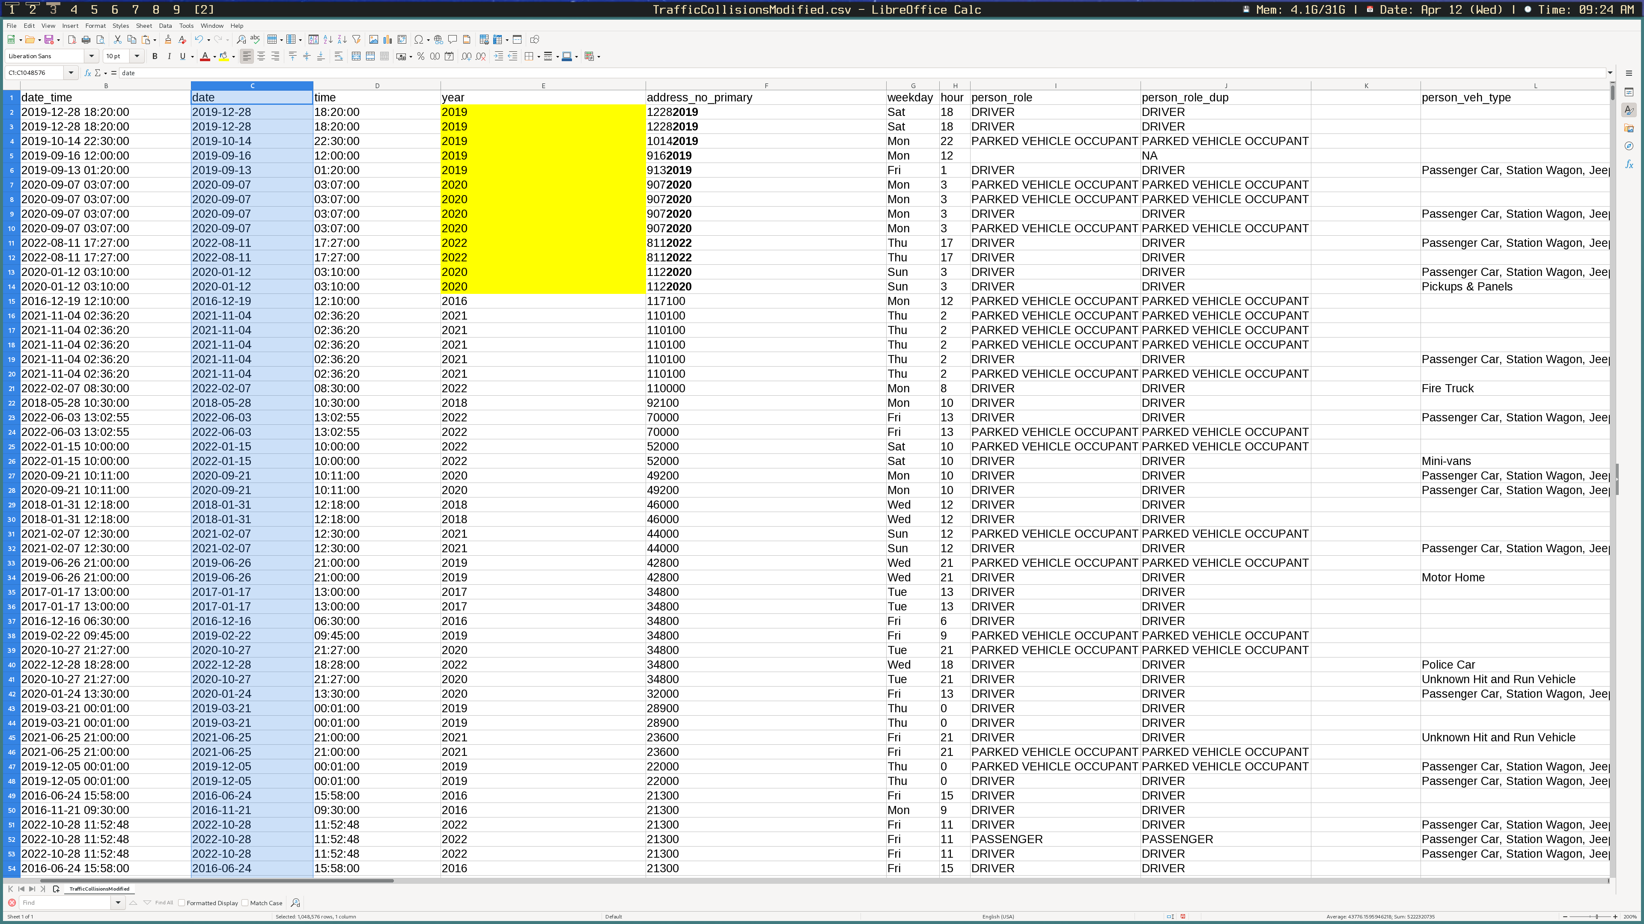
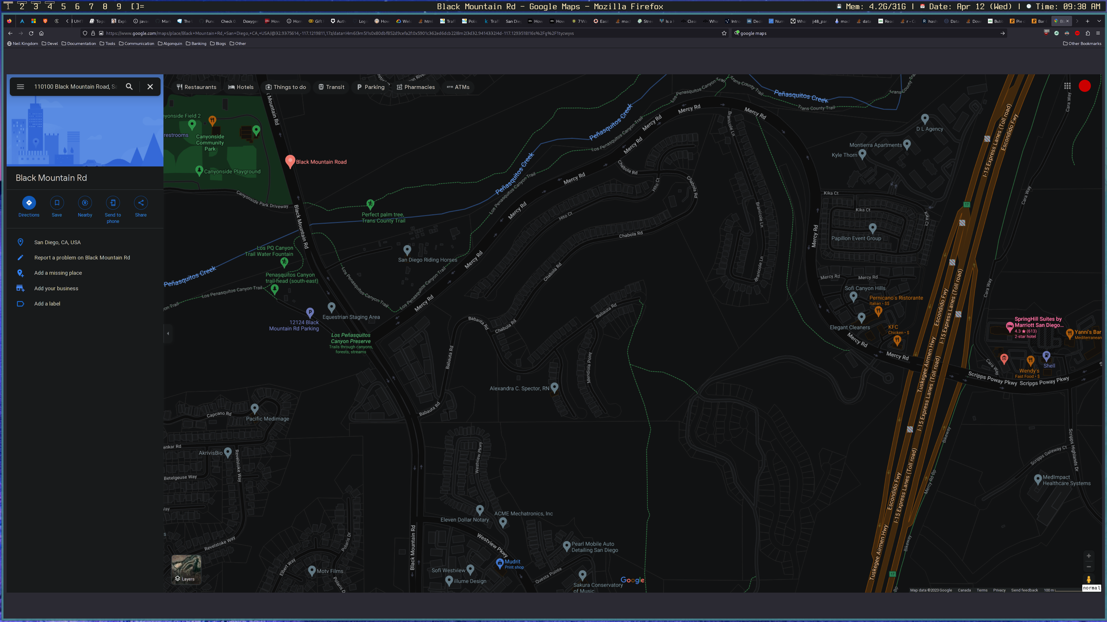
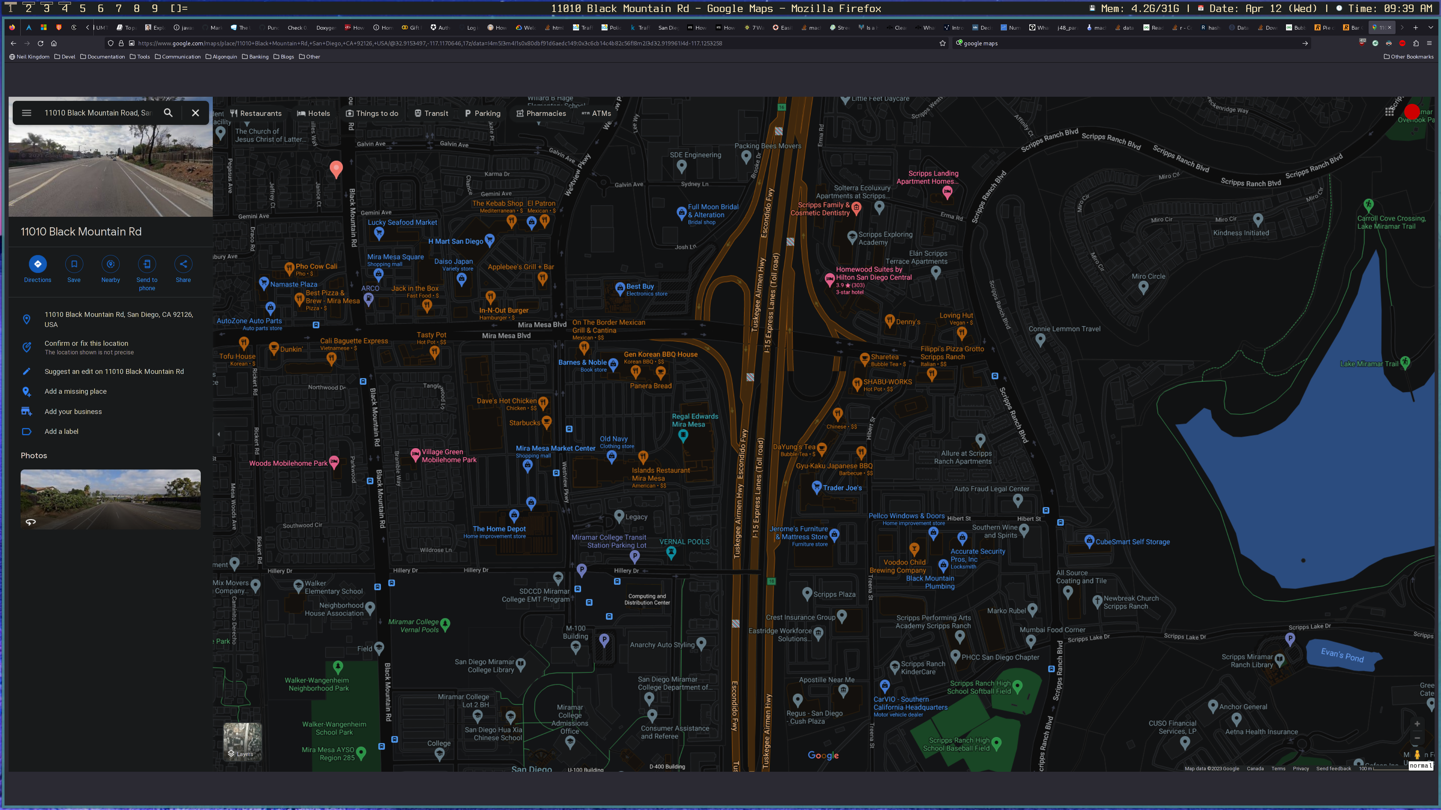
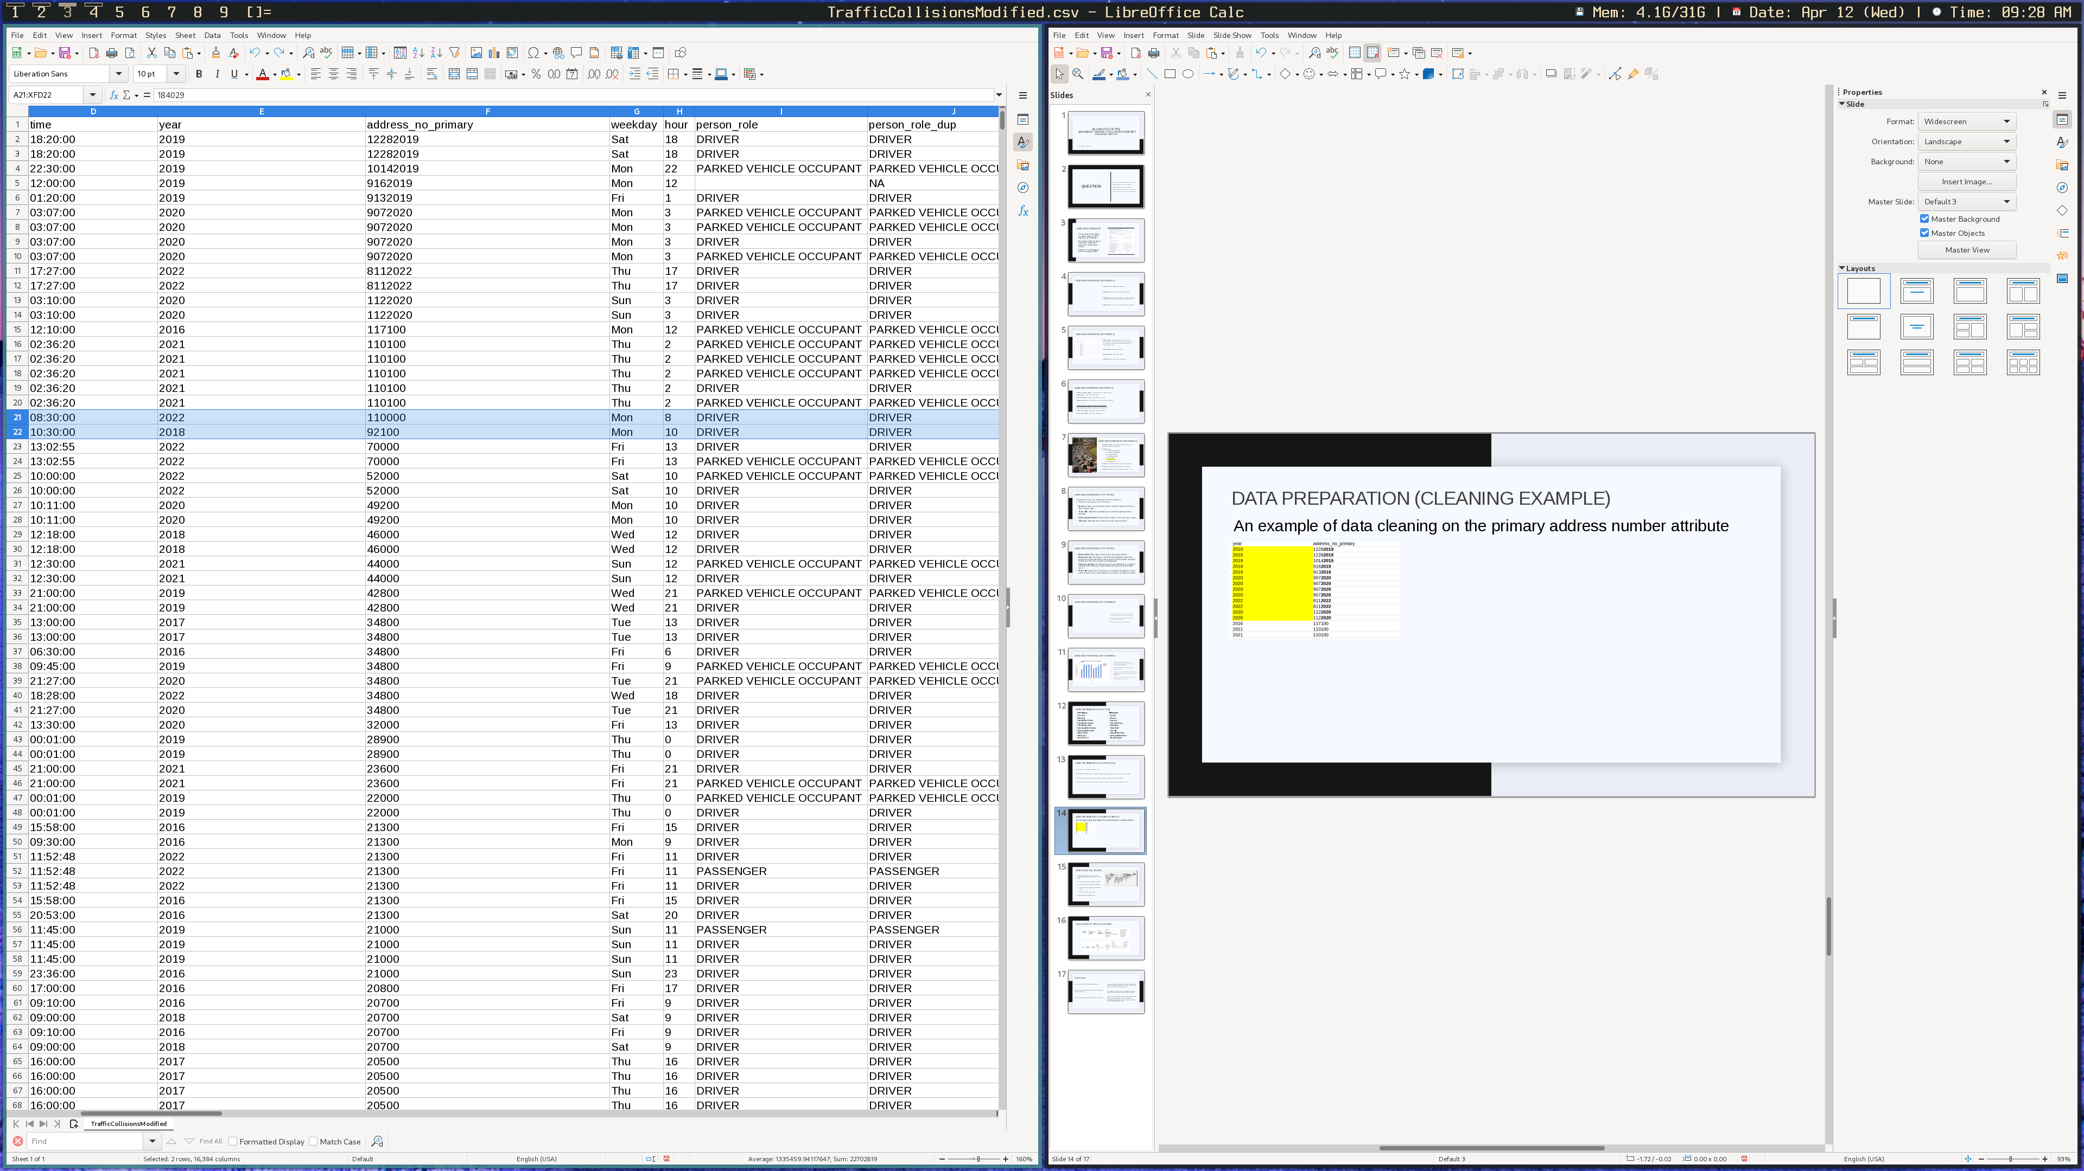
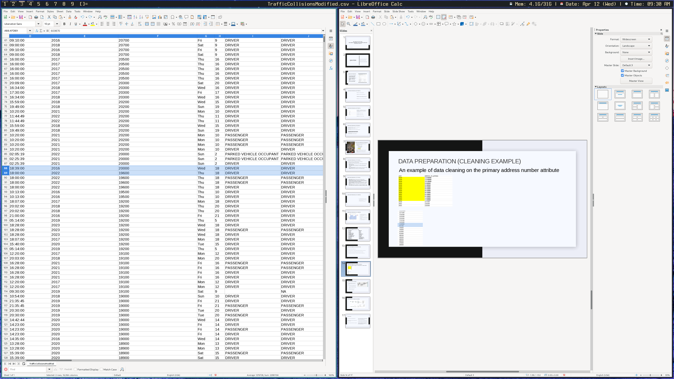
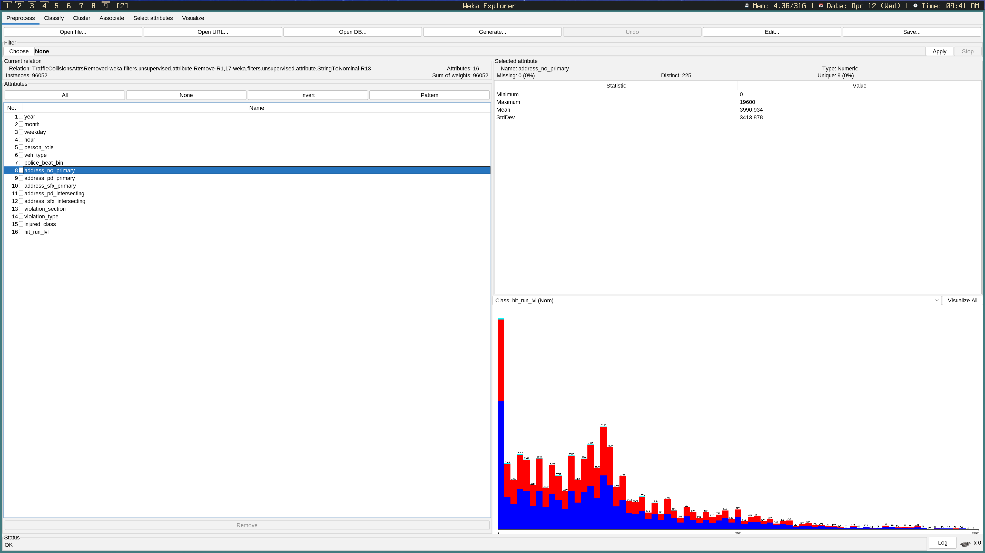
DATA PREPARATION (CLEANING EXAMPLE)
An example of data cleaning on the primary address number attribute
Years are appended to address number
Significant jumps in address number sequences

Slide 17
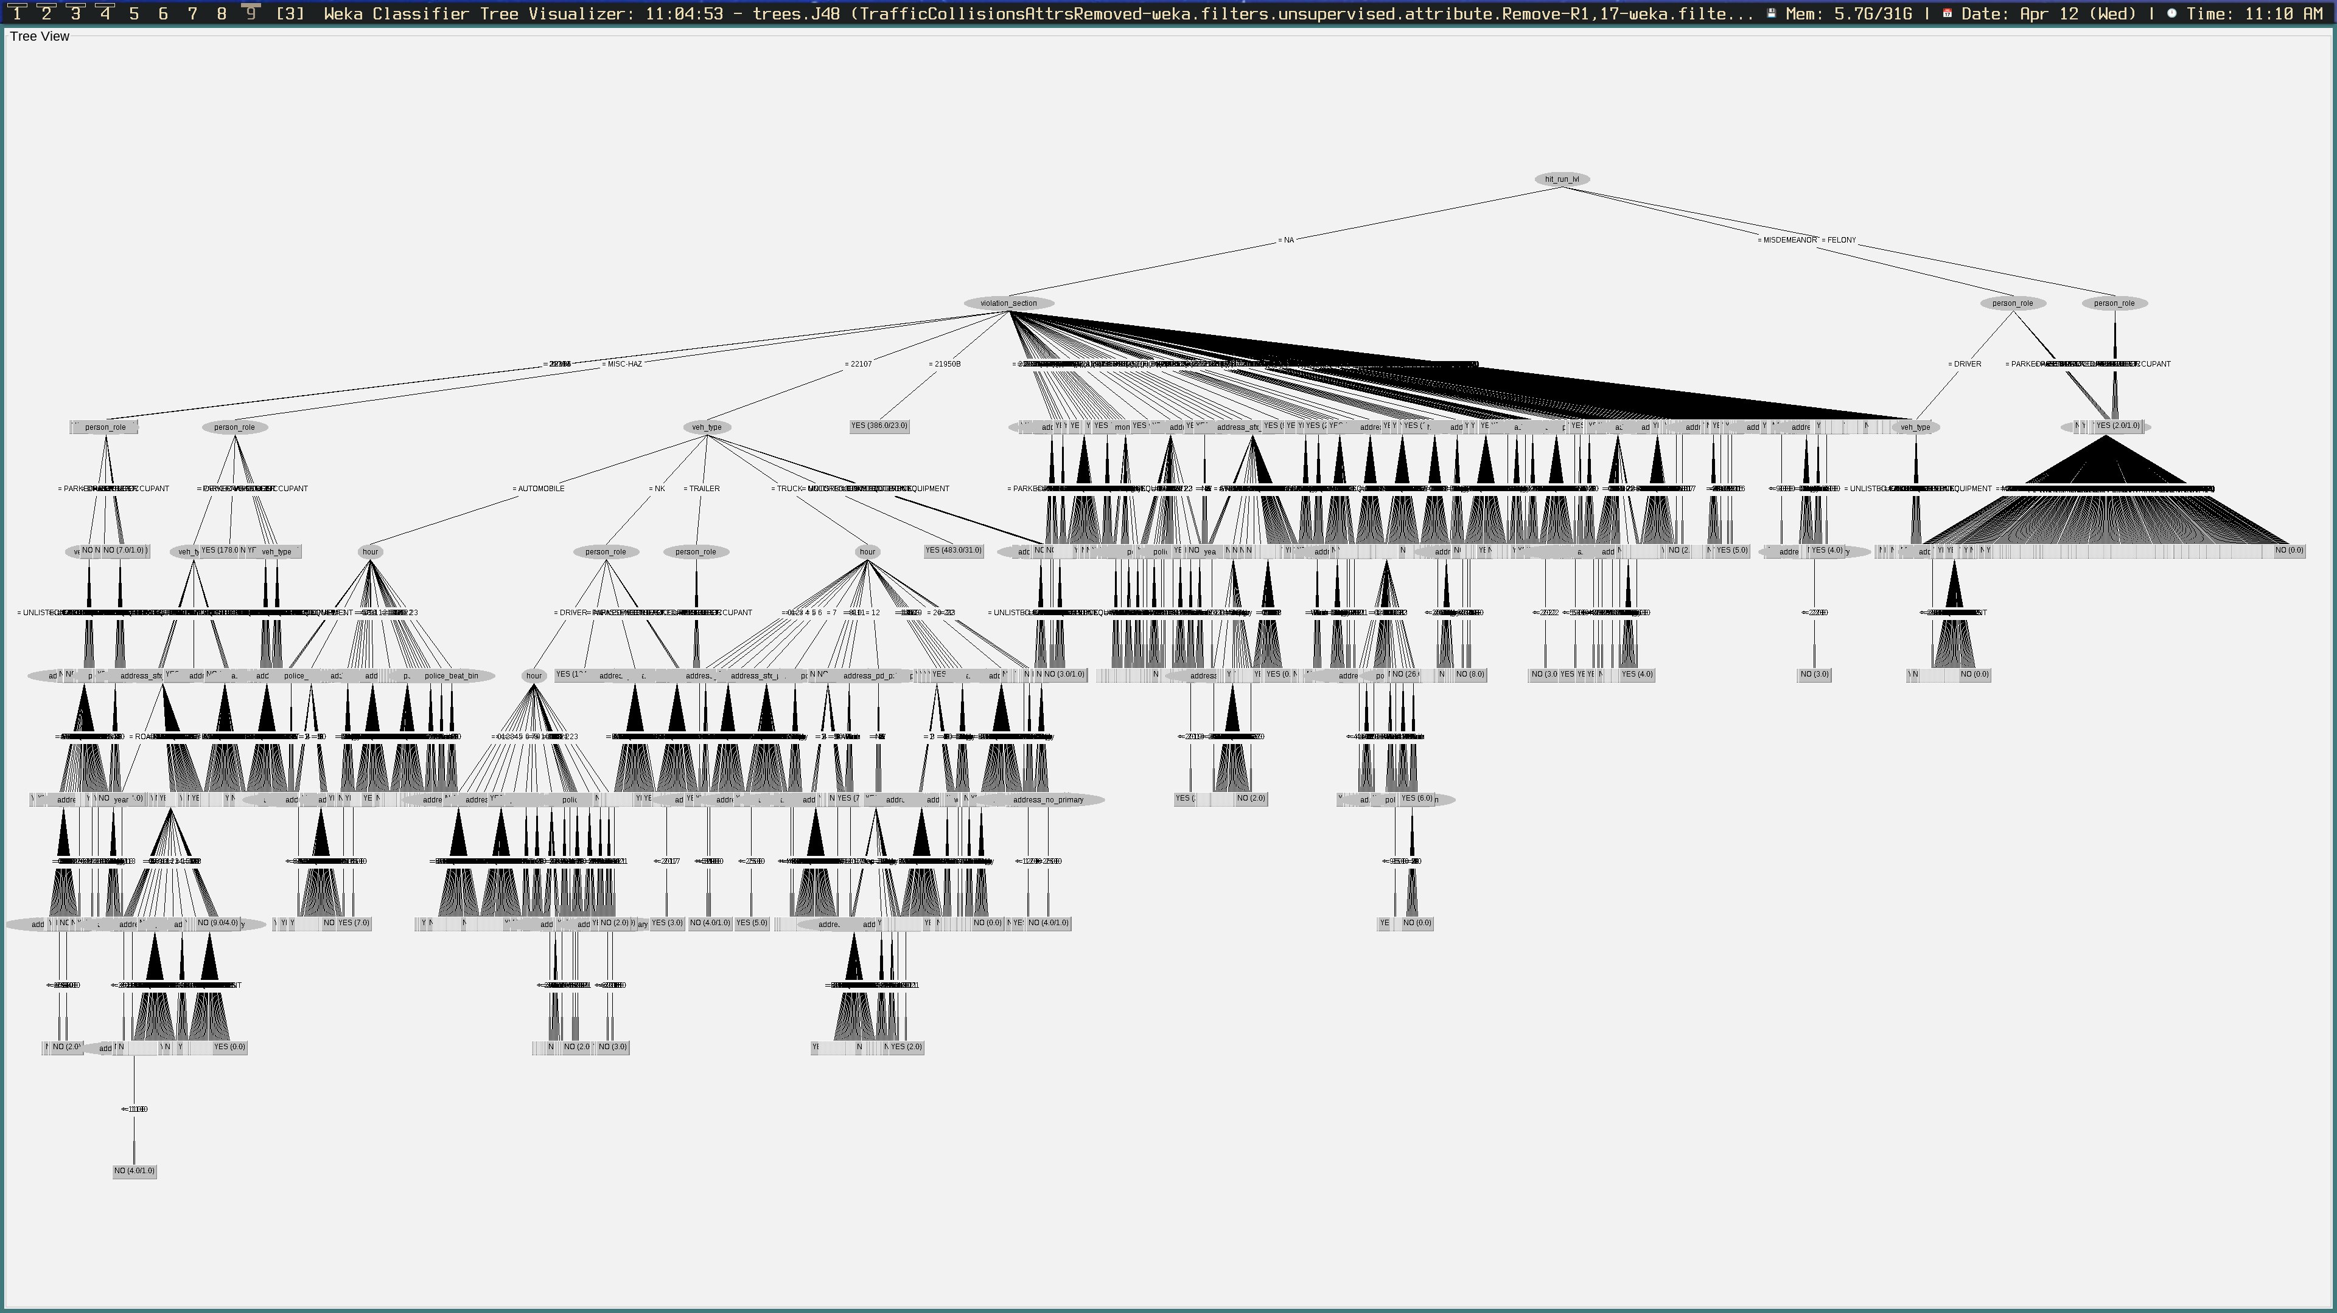
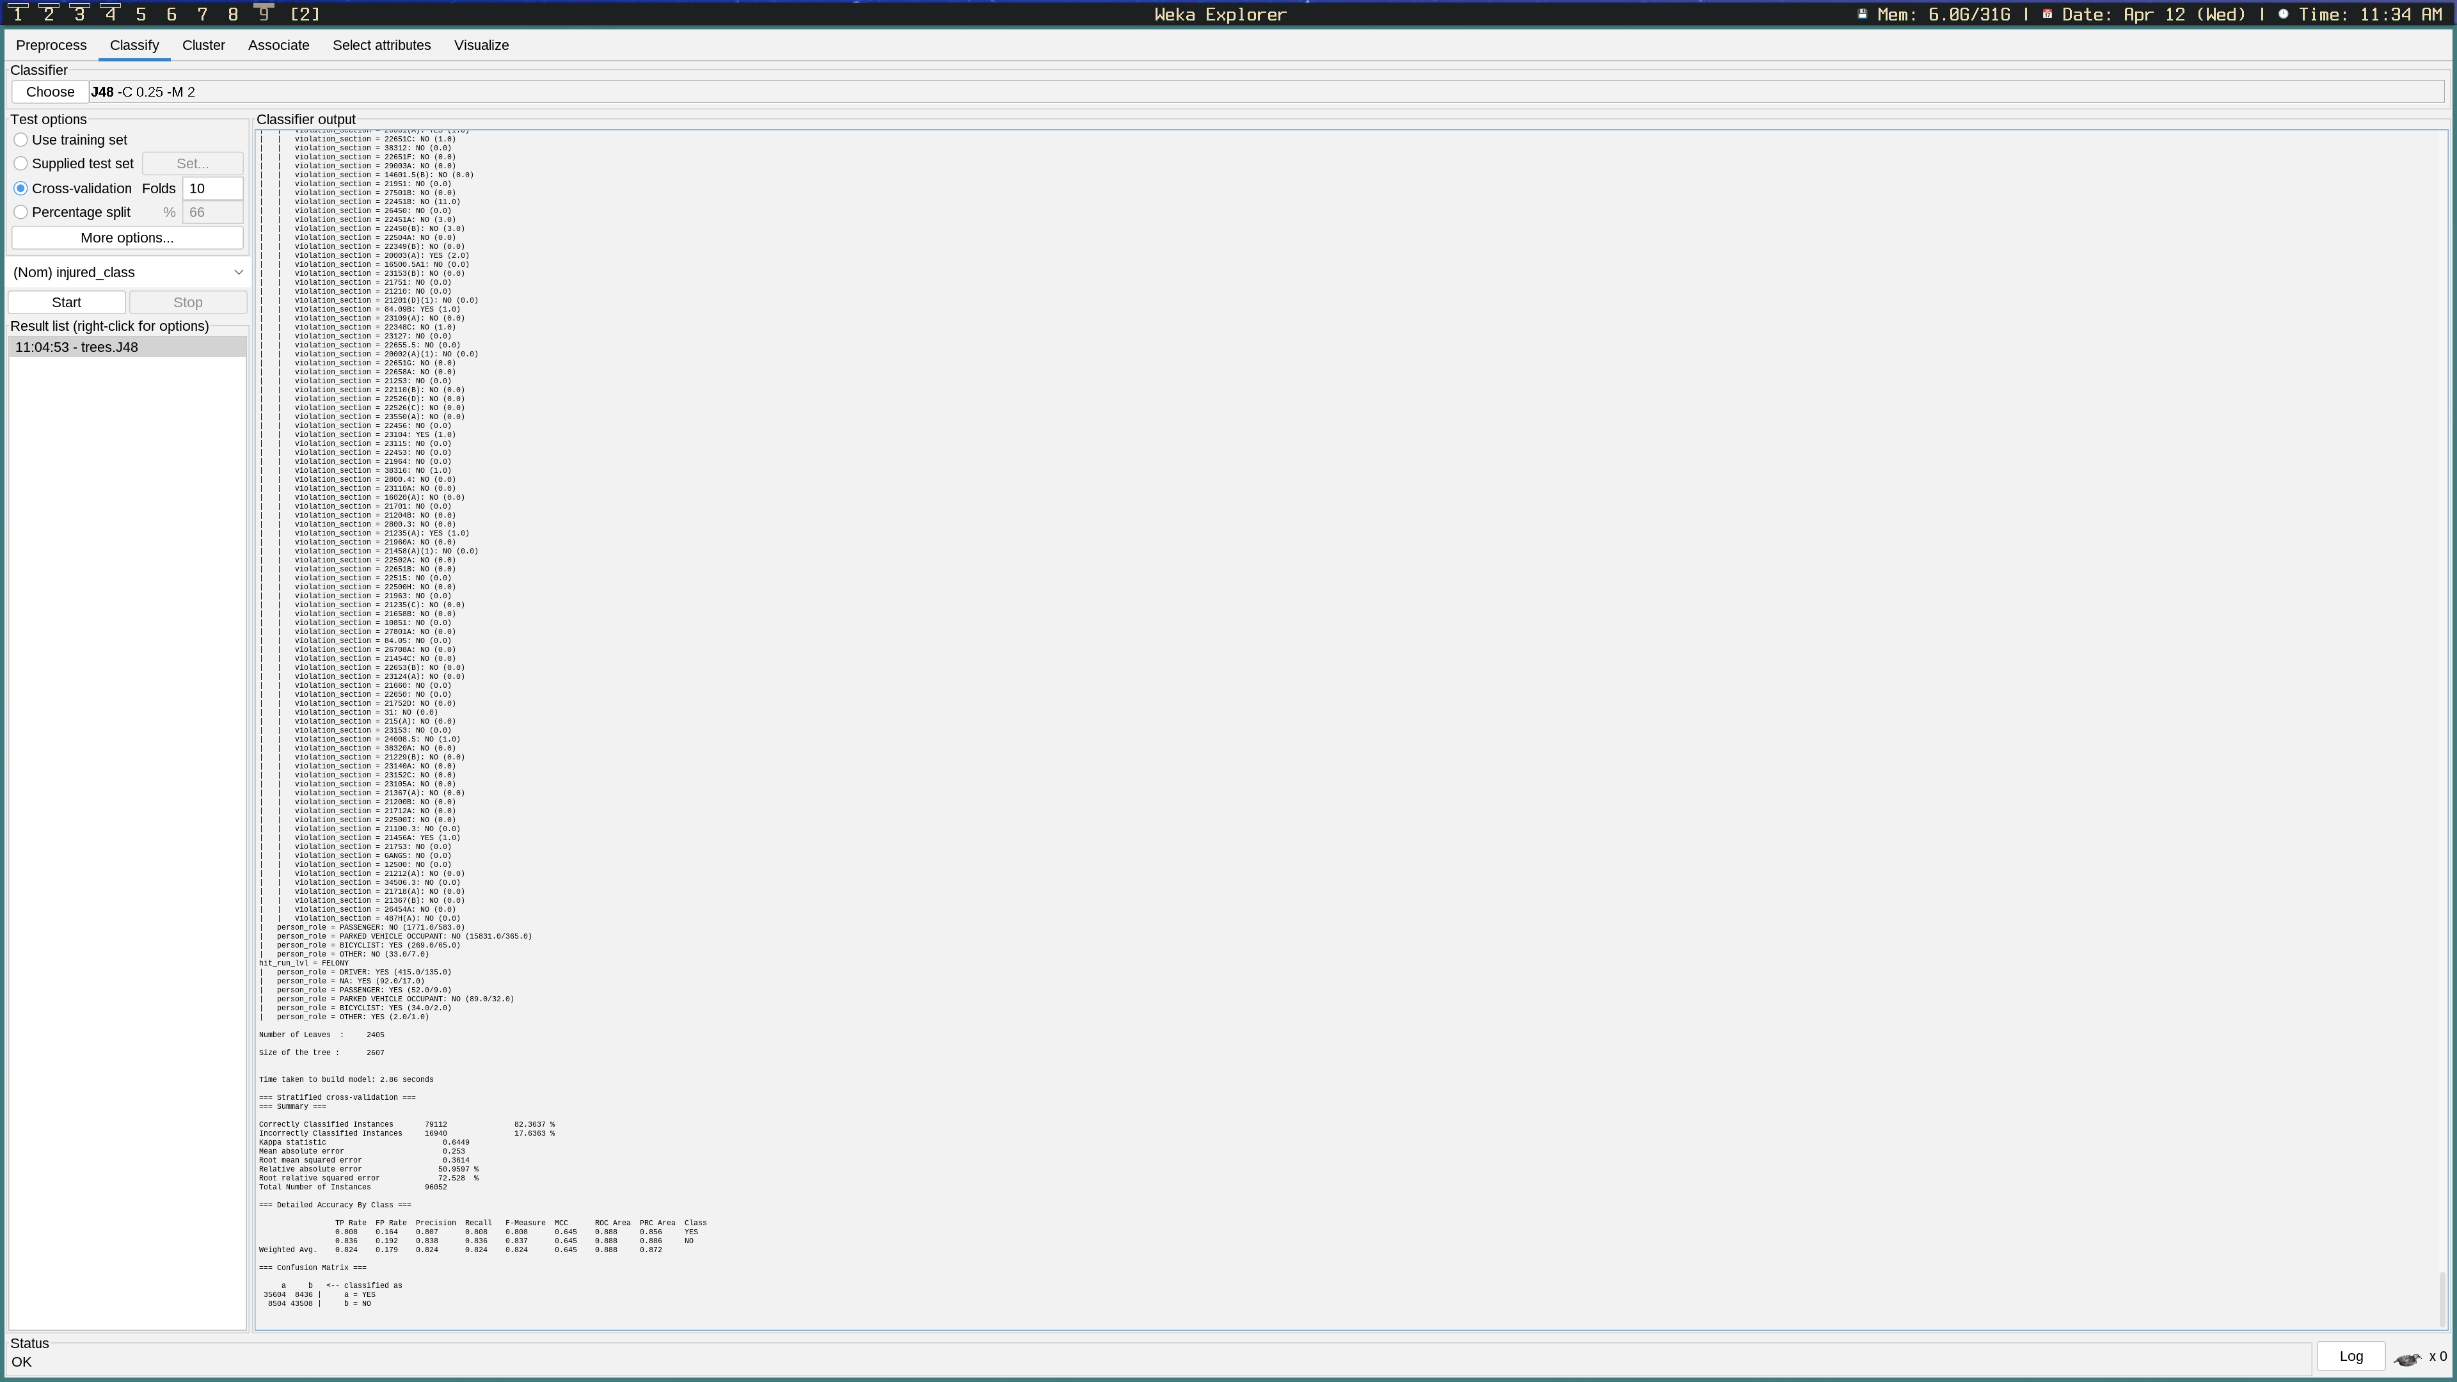
DATA MODELING (INJURY)
I began by using the J48 decision tree classifier algorithm using Injury as the class value
This was chosen for the following reasons:
Not as much data preparation required
A majority of the attributes were nominal values
Easy to visualize (well, not yet...)
Parameters were left untouched

Slide 18
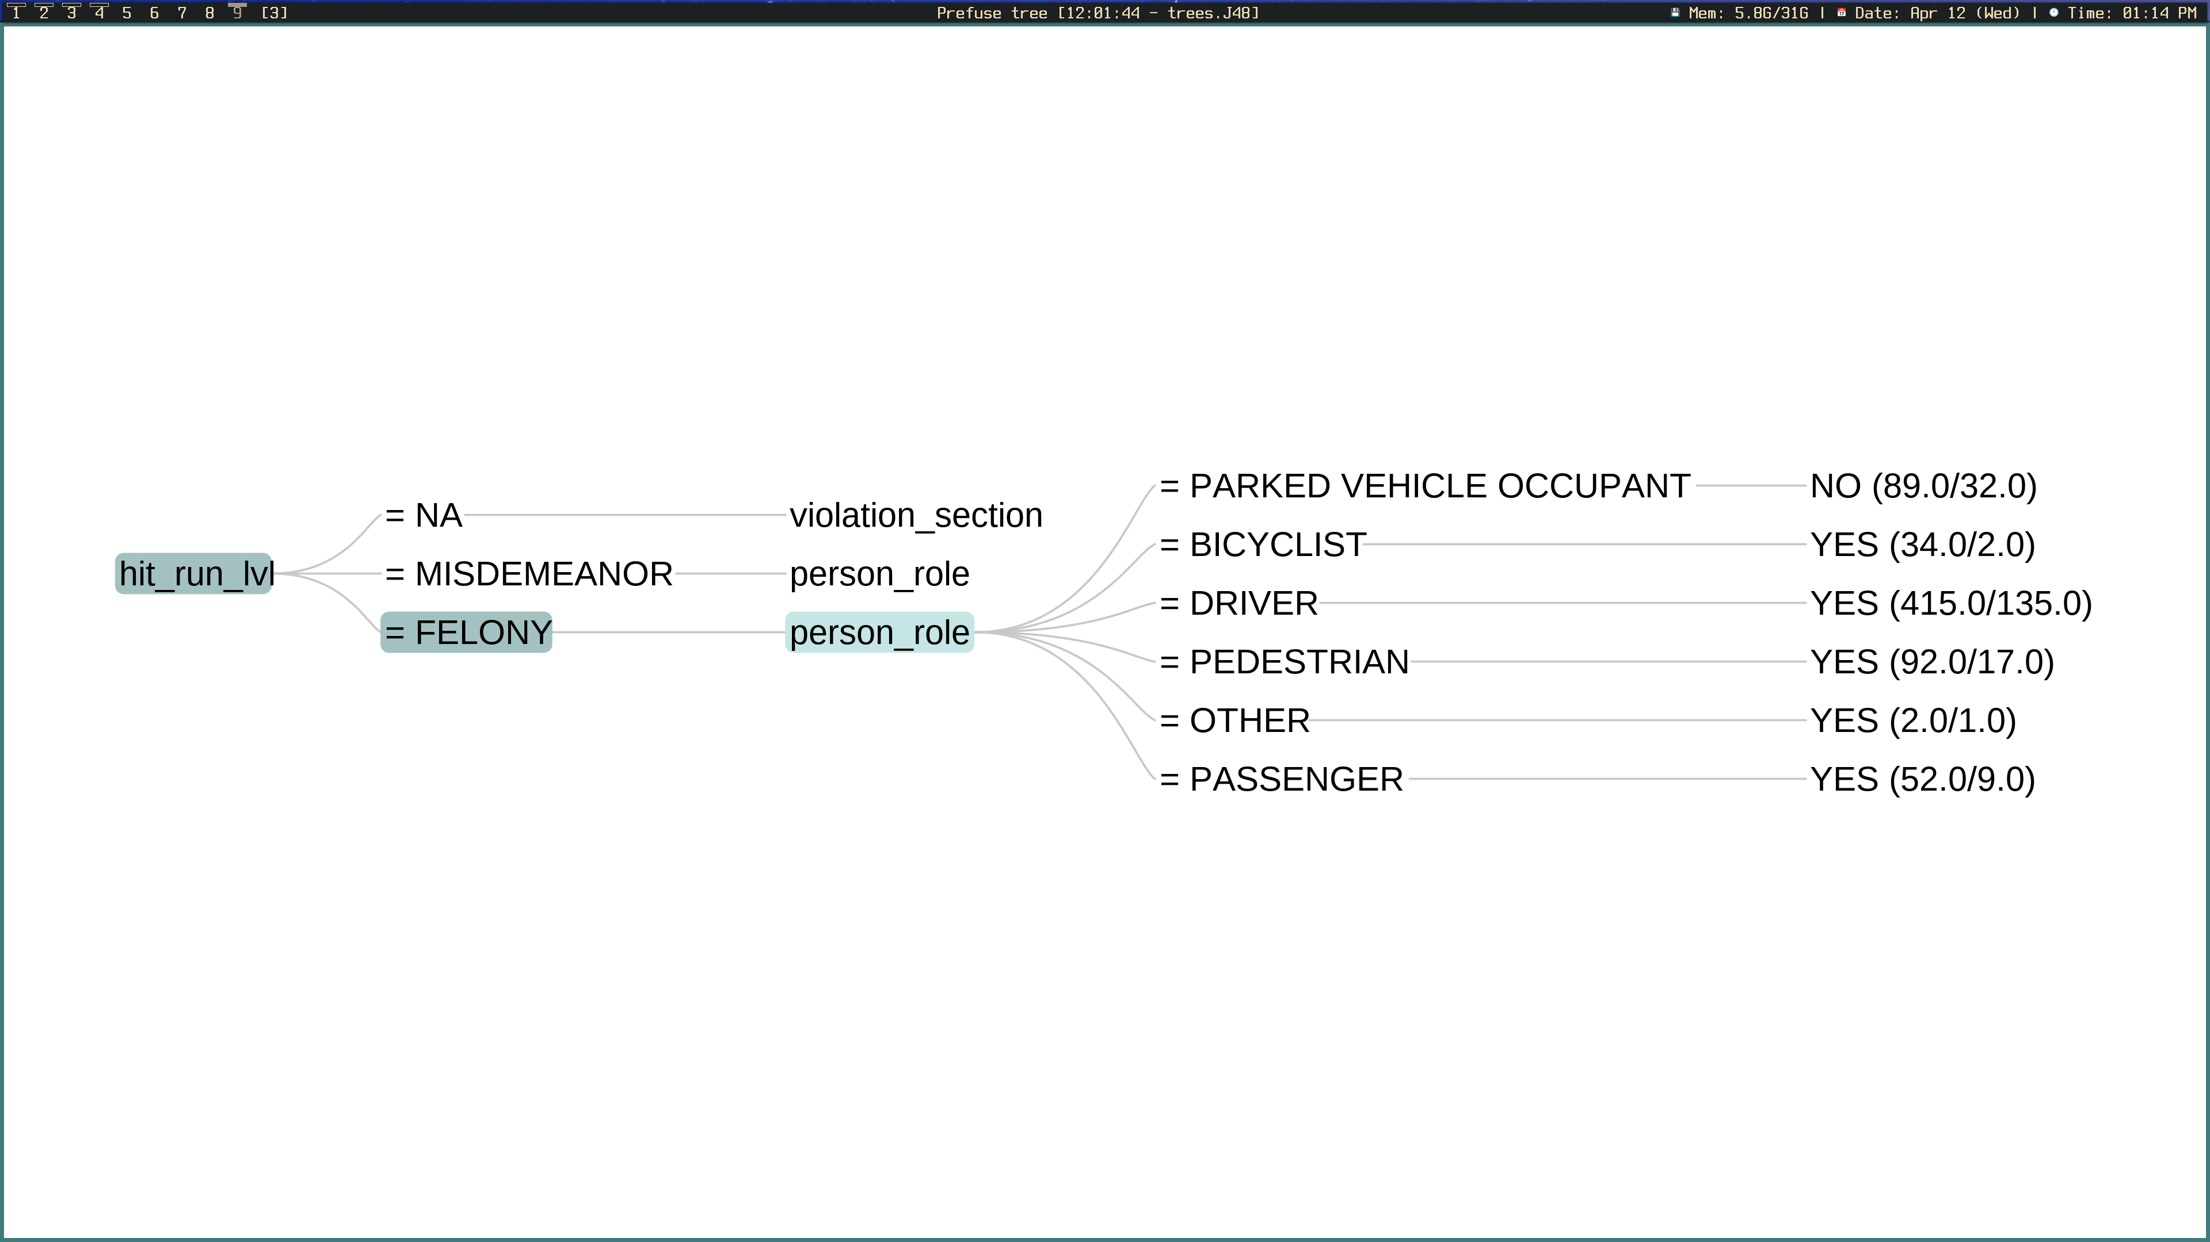
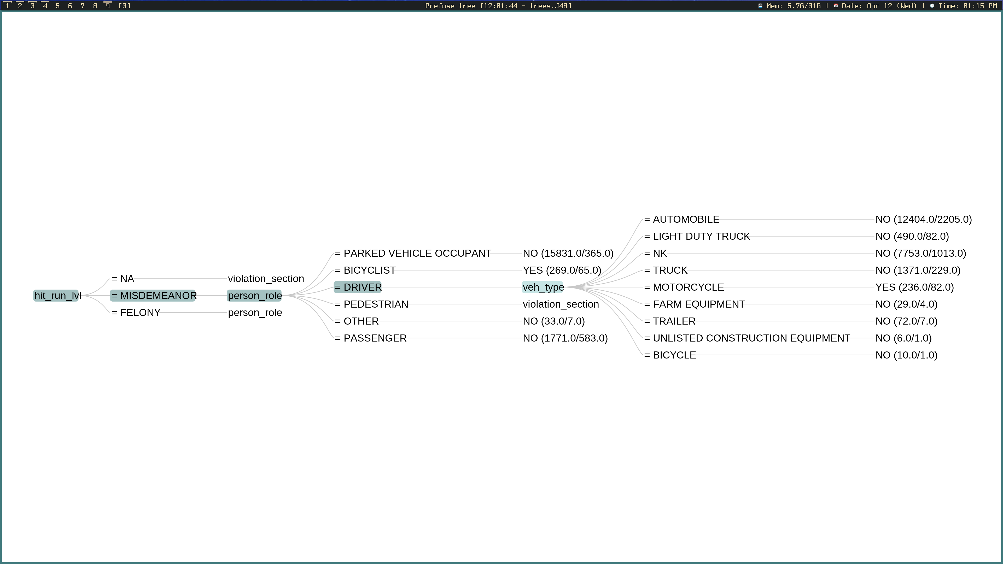
DISCUSSION OF RESULTS (INJURY)

Slide 19
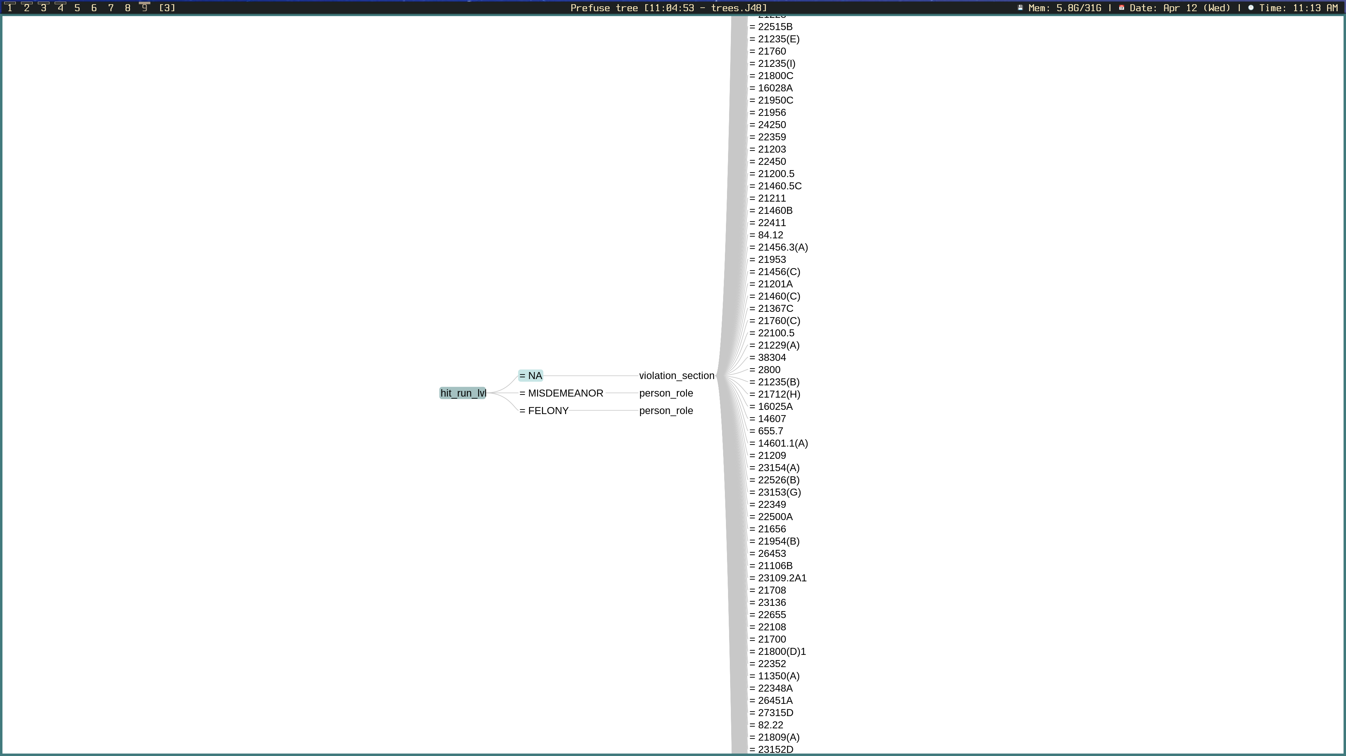
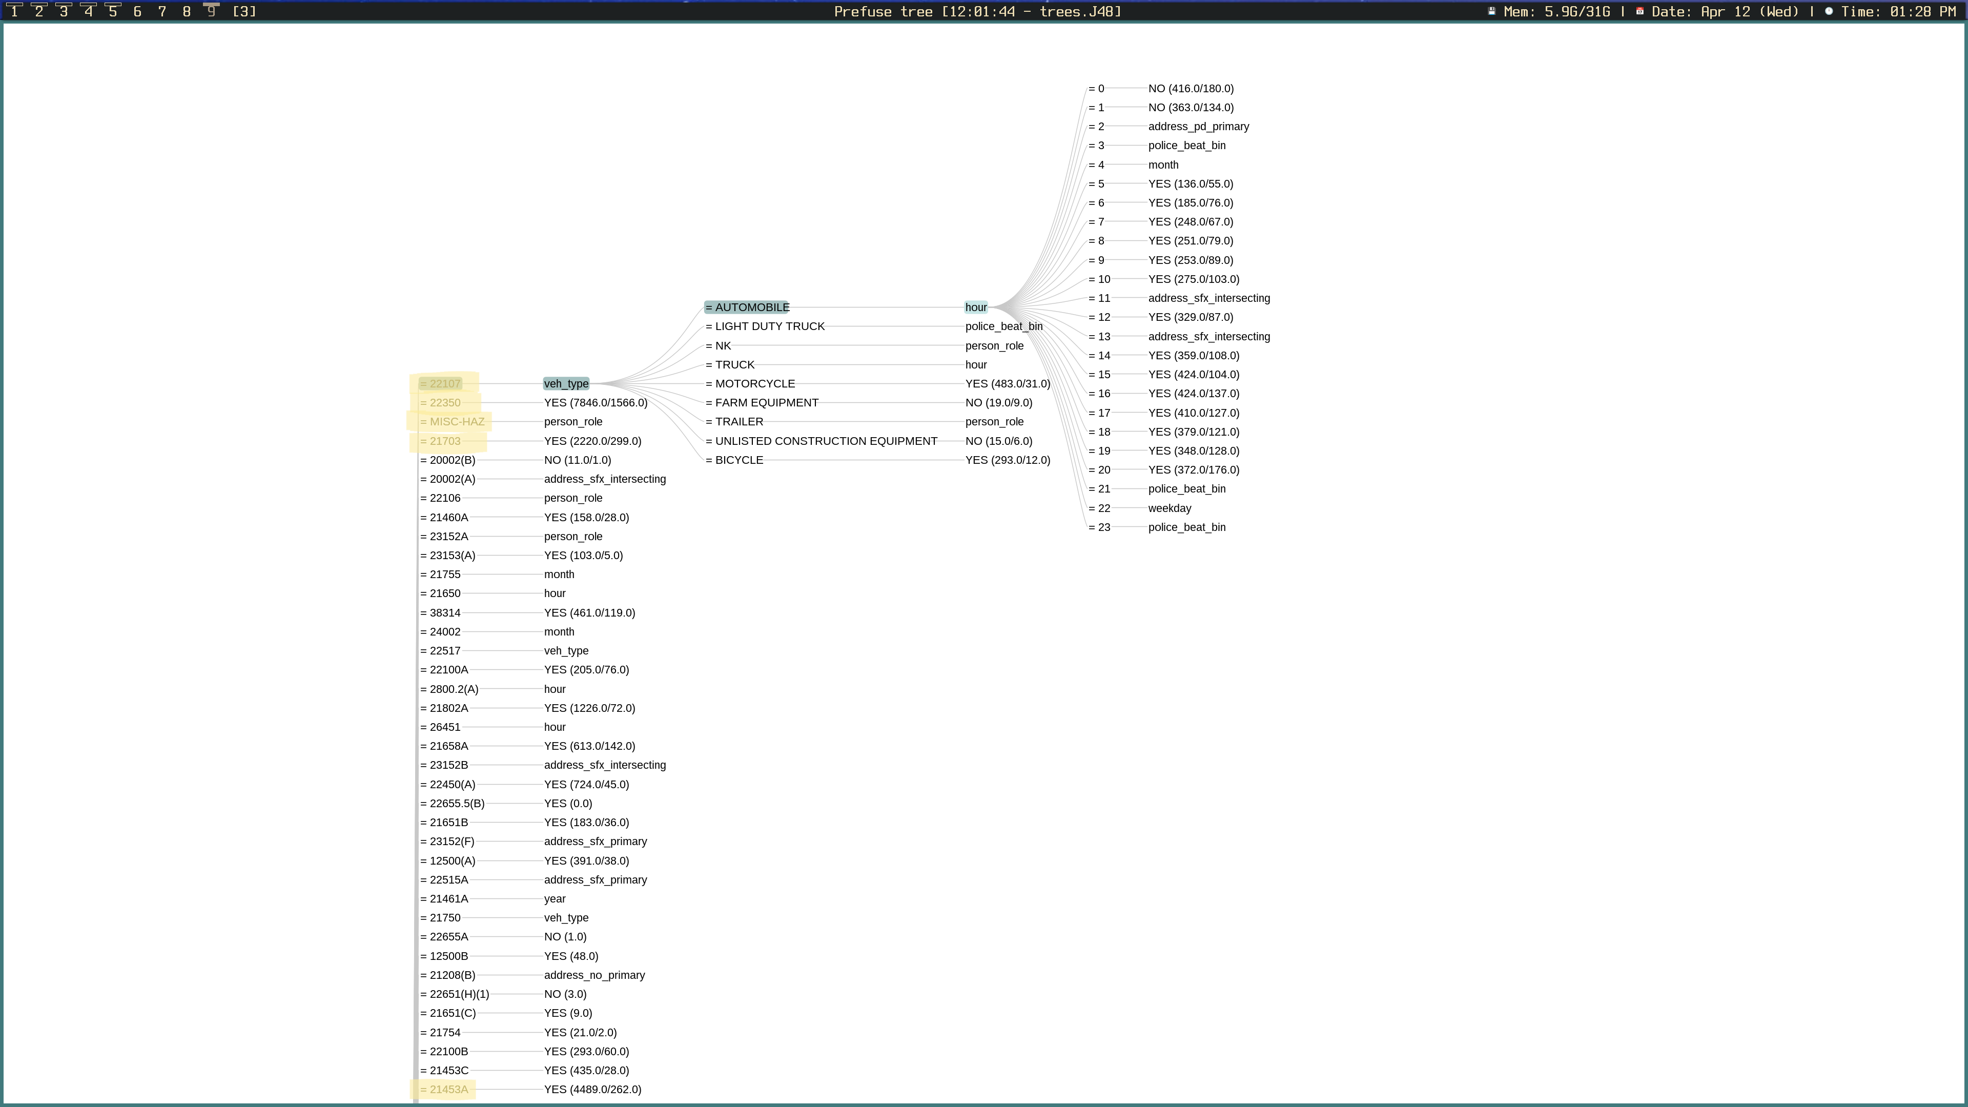
DISCUSSION OF RESULTS (INJURY)
The attribute with the highest information gain for normal collisions was the violation section
3 of the top 5 violation sections correlated with injury were leaf nodes, meaning that there was not much ambiguity in the model’s prediction
22107 (unsafe turning) and MISC_HAZ are understandably a bit more ambiguous, therefore further branching was required

Slide 20
CONCLUSIONS
Prediction Outcome
Date-time would have an effect on collision rates
Cyclist, motorcyclists, and pedestrians would have a higher rate of injury/fatalities
Violation section/type would have an effect on severity of the collision
A significant correlation between the hour of day and number of injuries was discovered. The least injuries occur at 4am, and the most occur at 5pm. Friday, Saturday, and Sunday appear to have the highest rate of injuries/deaths, as predicted.
This prediction was correct
This prediction was also correct. Naurally, the Vehicle Code (VC) violation type was more likely to be associated with injury and homicides than the other types. As we covered, there were a handful of violation sections that had a high correlation with injury and homicides

Slide 21
CONCLUSIONS
Prediction Outcome
Certain Police beats might have a higher collision rate due to busier streets
Certain address suffixes would have a higher degree of injuries and/or homicides
More injuries and deaths towards the North-East
Hit and runs marked as felonies would have a higher rate of injury and homicides in comparison to misdemeanors
Certain police beats, such as beat 122, had a substantial increase of injuries and homicides in comparison to others
Streets had the highest amount of injuries and deaths, followed by avenues, and then roads
The opposite was true. Significantly more injuries and deaths occurred in the South-West i.e., the heart of San-Diego. This makes more sense in retrospect.
This was, of course, correct

Slide 22
CONCLUSIONS
Question Answer
Why was this analysis important/necessary? What were the primary factors associated with injury and/or homicides?
What are the proposed solutions to these problems?
To gain a better understanding of the primary factors that lead to traffic collisions in the hopes that we can reduce risks associated with driving
Disregarding hit and runs, as there is not much we can do about those, unsafe turning, speeding, and running red lights are the largest factors that can potentially be reduced. Motorcyclists, bicyclists, and pedestrians are also at a disadvantage in terms of safety.
More bike paths or safety precautions for bikers, more red lights along long stretches of road, higher fines for running red lights, etc.

Slide 23
RefereNCES
Works Cited
Chang, Edward. “Traffic Collisions in San Diego.” Kaggle.com, 2020, www.kaggle.com/code/edchang1992/traffic-collisions-in-san-diego/notebook. Accessed 12 Apr. 2023.
“Cleaning Data.” Www.ibm.com, 2015, www.ibm.com/docs/en/spss-modeler/SaaS?topic=preparation-cleaning-data.
Ellis, Christina. “Number of Trees in Random Forests.” Crunching the Data, 27 Aug. 2022, crunchingthedata.com/number-of-trees-in-random-forests/.
Open, Diego. “City of San Diego Open Data Portal.” City of San Diego Open Data Portal, 2018, data.sandiego.gov/datasets/police-collisions-details/.
“San Diego Traffic Collision Analysis.” Datathon2019, nhtsai.github.io/datathon2019/. Accessed 12 Apr. 2023.
webcontroller. “Is a Hit & Run a Felony? - Potential Charges & Jail Time.” Valiente Mott, 20 Mar. 2020, valientemott.com/legal-terminology/is-a-hit-and-run-a-felony/. Accessed 12 Apr. 2023.
Yıldırım, Soner. “Decision Tree and Random Forest — Explained.” Medium, 11 Feb. 2020, towardsdatascience.com/decision-tree-and-random-forest-explained-8d20ddabc9dd.
Images
“1,600+ San Diego Traffic Stock Photos, Pictures & Royalty-Free Images - IStock.” Www.istockphoto.com, www.istockphoto.com/photos/san-diego-traffic. Accessed 12 Apr. 2023.
“Free Street Signs, Download Free Street Signs Png Images, Free ClipArts on Clipart Library.” Clipart-Library.com, clipart-library.com/street-signs.html. Accessed 12 Apr. 2023.
“Download Question Mark on Chalkboard Background. Vector. For Free.” Vecteezy, www.vecteezy.com/vector-art/1895648-question-mark-on-chalkboard-background-vector.

Slide 24

QUESTIONS?

